Slide 1
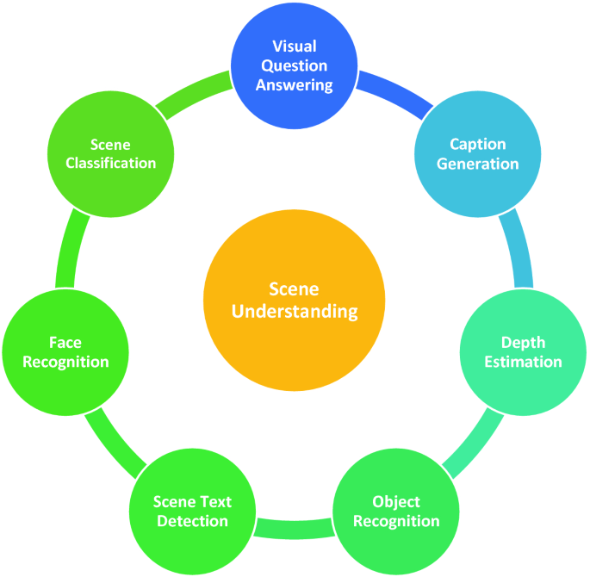
Deep Learning for Image Scene Classification
Deep learning has revolutionized the field of computer vision, enabling accurate and efficient image scene classification. This presentation explores the application of deep learning techniques to classify scenes in the Intel Image Classification dataset, highlighting the latest advancements and potential real-world applications.
Name:

Slide 2
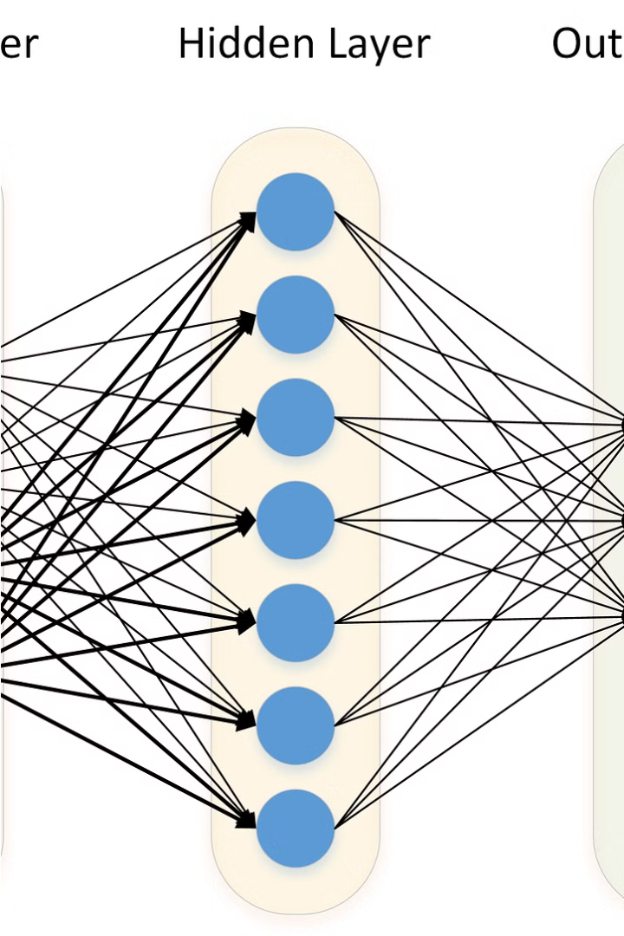
What is Deep Learning?
Deep learning is a powerful machine learning technique that utilizes artificial neural networks to learn and extract complex patterns from data. It has demonstrated remarkable success in a wide range of applications, including computer vision, natural language processing, and speech recognition.

Slide 3
Image Scene Classification
1
Understanding Visual Scenes
2
Diverse Applications
3
Challenges
This task is crucial in applications like autonomous vehicles, smart surveillance, urban planning, and environmental monitoring, where understanding the visual context is essential.
Accurately classifying complex, real-world scenes can be challenging due to factors like varying lighting conditions, occlusions, and the need for robust feature extraction.
Image scene classification is the task of categorizing an image into one of several predefined scene classes, such as buildings, forests, glaciers, mountains, seas, and streets.

Slide 4
The Intel Image Classification Dataset
Dataset Overview
Data Characteristics
Project Objectives
The Intel Image Classification dataset consists of 25,000 images across 6 scene categories: buildings, forest, glacier, mountain, sea, and street.
The images are high-resolution (150x150 pixels) and depict diverse real-world scenes, making the dataset a suitable benchmark for evaluating the performance of deep learning models.
This project aims to develop a deep learning-based image classification model that can accurately categorize the scenes in the Intel dataset, demonstrating the capabilities of deep learning in computer vision.

Slide 5

Deep Learning Techniques for Image Classification
1
Convolutional Neural Networks
Convolutional Neural Networks (CNNs) are a popular deep learning architecture for image classification, leveraging spatial and local features to achieve high accuracy.
2
Transfer Learning
Utilizing pre-trained models like VGG, ResNet, or Inception as a starting point can significantly improve performance and reduce training time.
3
Data Augmentation
Techniques like rotation, flipping, and scaling can be used to artificially expand the dataset, improving model robustness and generalization.

Slide 6
Model Development and Training
Model Architecture
Hyperparameter Tuning
The model architecture consists of convolutional layers, pooling layers, and dense layers, designed to extract relevant features and classify the input images.
Careful selection of hyperparameters, such as learning rate, batch size, and optimizer, is crucial for achieving optimal model performance.
Training and Validation
Evaluation Metrics
The model is trained on the Intel dataset, with a portion of the data reserved for validation to monitor and prevent overfitting.
Accuracy, precision, recall, and F1-score are used to evaluate the model's performance on the classification task.

Slide 7
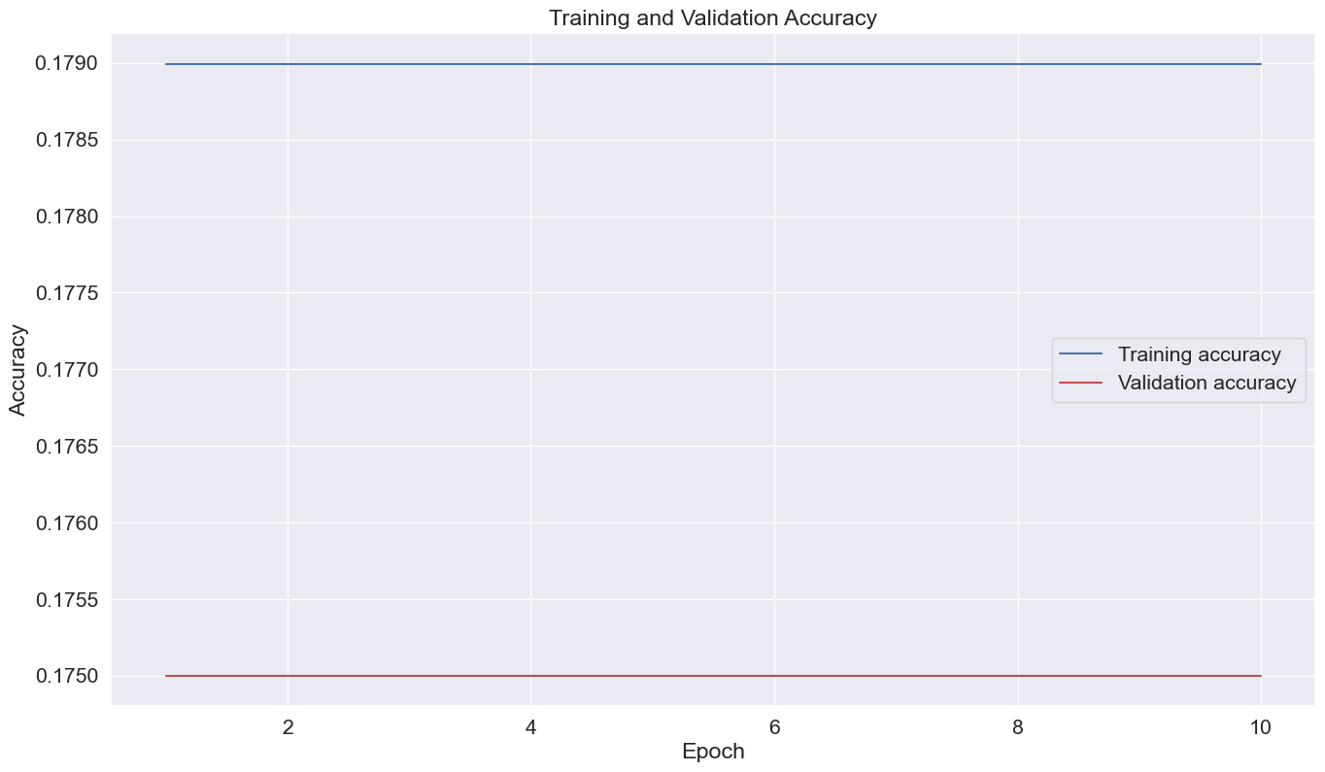
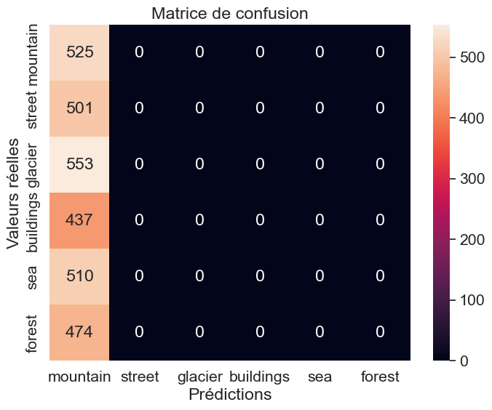
Results and Analysis
Training and Validation Accuracy
Confusion Matrix
The model achieves an overall training accuracy of 17.9% and a validation accuracy of approximately 17.5%, demonstrating its ability to effectively classify the various scene categories.
The confusion matrix provides insights into the model's performance, highlighting the specific scene categories where it excels or struggles.

Slide 8




Real-World Applications
Healthcare
Transportation
Security
Urban Planning
Deep learning-based image classification can aid in disease diagnosis, medical image analysis, and drug discovery.
Accurate scene classification is crucial for autonomous vehicle navigation, enabling better decision-making and safer roads.
Deep learning models can enhance video surveillance systems, enabling intelligent monitoring and detection of suspicious activities.
Scene classification can support urban planning and development by providing valuable insights into land use, infrastructure, and environmental conditions.

Slide 9




Future Directions and Conclusion
Limitations
Despite the impressive performance, deep learning models still face challenges such as interpretability, data dependency, and computational complexity.
Emerging Trends
Advancements in areas like meta-learning, few-shot learning, and self-supervised learning hold promise for overcoming current limitations.
Future Research
Continuous exploration of novel deep learning architectures, efficient training techniques, and interdisciplinary applications will drive further progress in the field.
In conclusion, this project has demonstrated the power of deep learning in the realm of image scene classification, showcasing its potential for real-world applications. By building upon the insights gained and addressing the current limitations, the future of deep learning in computer vision looks promising.

